Slide 1


Pan-African Conference on Environment, Climate Change and Health: Science to Policy

Slide 2
Theme:
Harnessing Science, Policy and Partnerships for environmental sustainability and Climate-Health Resilience.
Venue:
Emara ole Sereni Convention Center
Date:
21st – 24th October, 2025

Slide 3
The conference serves as: 1. The 4th climate and health, science to policy conference by CHANCE network 2. The 2nd ARIN international climate and health and conference. 3. The 4th health and climate change scientific conference by ministry of health and KEMRI. 4. The inaugural national environment conference by ministry of environment, climate change and forestry (MOECC&F) and the national environment management authority (NEMA)

Slide 4








Convenors:

Slide 5
Environment, Climate Change & Health in Africa: The urgency for action. - Developing countries, especially in Africa, are disproportionately impacted by climate change. - Vulnerable populations face worsening health, food insecurity, and economic instability. - Environmental issues like rising temperatures, erratic rainfall, and pollution drive disease outbreaks (e.g., Malaria, Cholera, Dengue). - Kenya faces intensifying climate-related health and socio-economic challenges. - There is an urgent need to translate scientific evidence into policies and action. - Stronger multisectoral collaboration and knowledge exchange are critical for effective adaptation and mitigation.

Slide 6
Building on a strong foundation of science-policy engagement - Builds on prior CHANCE conferences: Pretoria (2022), Gaborone (2023), Harare (2024) - Builds on ARIN's 2024 climate & health conference (transdisciplinary research focus) - Leverages Kenya's ministry of health & KEMRI experience (Nairobi 2019, Kwale 2023, Machakos 2024) - Brings together researchers, policymakers, private sector, donors & civil society - Focus areas: science-policy translation, innovation showcase, capacity building - Promotes best practices for climate action, health resilience & economic growth - Includes community-led orgs to uplift climate-health literacy & indigenous knowledge

Slide 7
Why this conference matters: from conversation to action - Drives measurable impact: moves beyond dialogue to trackable commitments and real-world implementation. - Launches research-policy labs: virtual labs where policymakers & researchers co-develop solutions to climate-health challenges. - Builds long-term partnerships: fosters a lasting ecosystem of science-policy-innovation collaborations. - Tracks policy progress: reviews outcomes from past conferences (MoH, ARIN, CHANCE, KEMRI, etc.) To inform the 2025 state of evidence report on Environment, Climate Change and Health in Africa. - Establishes a TWG: drives integration of health into environment and Climate Change policies, NDCs, and CoPs. - Strengthens financing & civil society alliances: supports joint advocacy and mobilization toward COP30–COP32, UNCBD COP16, UNCCD COP17. - Shapes future agendas, e.g CHAC 2026, CoP 32, biennial national environment conference, and post-CoP implementation plans. - Welcomes global partners: engages actors like UNEP, AGNs, and innovators to build skills for integrating health in climate negotiations.

Slide 8

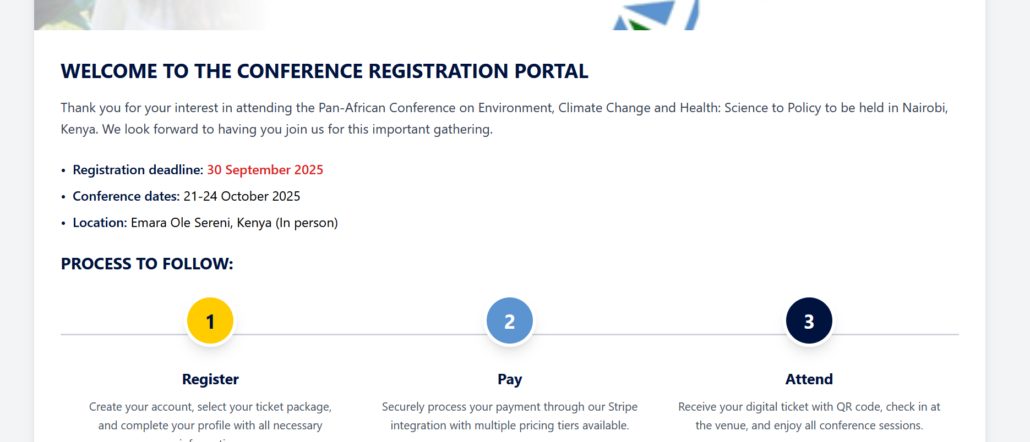


Slide 9
Scientific Tracks (Abstract Submissions Deadline Extended from from August 3rd August to 10th August) 1. Evidence and Interventions for Infectious Diseases. 2. Extreme heat risks and management. 3. Transdisciplinary Approaches for Climate- Resilient Environmental and Health Systems. 4. Nature, Ecosystems, and Sustainable Economies for Health and Wellbeing. 5. Equity, Ethics, Justice, and Inclusive Adaptation in the Environment–Climate–Health Nexus. 6. Governance, Leadership, Cross-Sector Collaboration, and Policy for Integrated Environment- Climate change and Health action 7. Climate Finance for Health and Environmental Adaptation and Resilience 8. Land Use, Urbanization, and Built Environments in a Changing Climate for Healthy Cities. 9. Technological Innovations and Digital Solutions for Climate, Environment, and Health.

Slide 10
Sponsorship Packages
Benefit/Feature | Platinum ($25,000) | Gold ($15,000) | Silver ($10,000)
Branding & Visibility | ✔ Logo & link on conference and organizing institutions' websites ✔ Prime logo placement on all materials (Digital) ✔ Full-page ad in brochure & final report ✔ 5 teardrop banners ✔ Recognition at opening & closing ceremonies | ✔ Logo & link on websites ✔ Prime logo placement on all materials (Digital) ✔ Half-page ad in brochure & final report ✔ 3 teardrop banners ✔ Recognition at opening & closing ceremonies | ✔ Logo & link on websites ✔ Prime logo placement on all materials (Digital) ✔ Quarter-page ad in brochure & final report ✔ 2 teardrop banners
Speaking & Engagement | ✔ Speaking at Opening & Closing Ceremony, 1 Plenary Session, 2 Side Events ✔ Host exclusive side event/panel | ✔ Speaking at Opening Ceremony, 1 Plenary, 1 Breakout Session ✔ Host exclusive side event/panel | ✔ Speaking at 1 Breakout Session
Registrations | 8 complimentary registrations | 6 complimentary registrations | 4 complimentary registrations
Exhibition & Promo Exposure | ✔ Reserved seating at plenary sessions ✔ 3x3m branded booth in high-traffic area | ✔ Reserved seating at plenary sessions ✔ 3x3m branded booth in high-traffic area | —
VIP Perks & Digital Exposure | ✔ Speaker bio & profile in program & website, 3 push notifications in event app, Fast-track registration & VIP access, Translation services, Prime listing in pre-event marketing | ✔ Speaker bio & profile in program & website, 2 push notifications in event app, Fast-track registration & VIP access, Translation services, Listing in pre-event marketing | ✔ 1 push notification in event app, Fast-track registration & VIP access, Translation services, Recognition in mobile app & promotional materials

Slide 11
Additional Sponsorship packages and Conference experience
Benefit/Feature | Civil Society / CBOs / Startups ($2,500) | Exhibitor ($1,000) | Intl. Delegate Sponsor ($3,000) | Regional Delegate Sponsor ($2,000)
Branding & Visibility | ✔ Logo & link on websites ✔ Recognition in final report & program | ✔ Logo & link on websites ✔ Prime logo placement on all digital materials ✔ Recognition in final report & program | ✔ Logo on website & app ✔ Recognition in opening remarks & promotional materials | ✔ Logo on website & app ✔ Recognition in opening remarks & promotional materials
Speaking / Recognition | ✔ Recognition at opening as supporting partner✔ Org profile in program & website | — | ✔ Acknowledgment in opening remarks✔ Listed in comms | ✔ Acknowledgment in opening remarks ✔ Listed in comms
Engagement & Networking | ✔ 2 complimentary registrations ✔ Co-host grassroots-focused session | ✔ 2 complimentary registrations | ✔ 2 complimentary registrations (travel and accommodation not included) +1 fully sponsored delegate | ✔ 1 complimentary registration (travel and accommodation not included) + 1 fully sponsored delegate
Exhibition & Promo | Refer to exhibitor package if applicable | ✔ 3x3m branded booth✔ Name/logo in directory✔ Display promotional materials | — | —
Perks & Exposure | ✔ Priority registration ✔ Translation access ✔ Recognition in mobile app & promo materials ✔ Listed in pre-event marketing | ✔ Listed under exhibitor section in app | ✔ Sponsor name listed across all comms | ✔ Sponsor name listed across all comms

Slide 12
Conference experience Sponsorship Packages
Package | Investment | Description | Sponsor Benefits
Lanyards & ID Pouches | $3,000 | Branded lanyards and badge pouches worn by all participants, co-branded with the conference logo and theme. | ✔ Logo co-branded on all delegate lanyards✔ High visibility across all attendee photos and interactions✔ Recognition in final program & promotional materials✔ Logo on conference website
Opening Cocktail Reception | $4,500 | High-visibility networking event held in the exhibition hall after the opening session. | ✔ Pull-up banners and promotional materials allowed✔ Sponsor mention during opening ceremony✔ Logo on website, program, and mobile app✔ Exposure to VIPs, policymakers, and influencers
Hosted Breakfast Event | $4,000 | Private breakfast session for up to 50 high-profile participants, featuring a panel or discussion hosted by sponsor. | ✔ Branded session in premium venue✔ Full buffet for 50 attendees✔ Panel moderation opportunity✔ Logo on backdrop, agenda, website, and app✔ Two complimentary registrations✔ Distribute branded materials✔ Social media mentions
Networking Lounge Sponsorship | $5,000 | A dedicated, branded lounge space within the venue for delegates to connect and collaborate. | ✔ Sponsor-branded networking area✔ Logo on signage, lounge backdrop, digital platforms✔ Display space for banners, screens, or flyers✔ Recognition in opening & closing ceremonies✔ Two complimentary registrations✔ Recognition on social media, website, and app

Slide 13





Sponsors & Partners

Slide 14
Why technically support/sponsor this conference? - Be visibly aligned with Africa's foremost platform tackling the urgent intersections of climate change, health, and development. - Engage with ministers, UN agencies, development banks, and leading scientists influencing national and continental agendas. - Gain widespread brand exposure through multi-channel marketing; including websites, social media, mobile app, signage, and the final conference report. - Contribute thought leadership in plenaries, side events, and exclusive hosted sessions—driving real science-to-policy impact. - Showcase your organization’s contribution to achieving the sustainable development goals. - Build partnerships with a diverse community of funders, researchers, civil society, and the private sector committed to co-developing solutions for africa’s climate and health challenges. - Your sponsorship directly enables grassroots leaders, youth, and community-based actors from underserved regions to take part. -Beyond a single event, your support strengthens a growing movement driving transformative action across africa’s climate and health landscape.

